Slide 1


TeleGroup system
Charting your course through the #TECHUNIVERSE
www.telegroup-ltd.com
Confidential and proprietary information of
TeleGroup. © All rights reserved worldwide

Slide 2

#TECHUNIVERSE
TeleGroup
We are a business system comprised of technology companies specialized in developing and implementing IT solutions and infrastructure engineering services.
Our markets are the Western Balkans, the EU,
and the Middle East.
What do we do?
We analyze business processes and implement optimal solutions for connecting, digitalizing, automating, and protecting your overall business.
Our clients come from both the Public
and private sectors.
www.telegroup-ltd.com
Confidential and proprietary information of
TeleGroup. © All rights reserved worldwide

Slide 3

TeleGroup system
1992 Founded
30+ Years
400+ Clients
6 Countries SRB, BIH, CG, SLO, CRO
€45,7M Turnover in 2025
450+ Employees
10 ompanies in the system
600+ Expert certificates
C
www.telegroup-ltd.com
Confidential and proprietary information of
TeleGroup. © All rights reserved worldwide

Slide 4




Our business philosophy
01
02
03
Mission
We provide organizations in the European and Middle Eastern markets with optimal technological solutions to help them connect, digitalize, automate and protect their business.
Vision
To be a driving force in the creation of smart technologies and help organizations in the global market to accomplish their full business potential.
Values
Quality Innovation Integrity Partnership CSR
www.telegroup-ltd.com
Confidential and proprietary information of
TeleGroup. © All rights reserved worldwide

Slide 5


Integrated management system
By applying international business standards in our everyday operations, we win our users’ hearts.
Quality
management
Environmental
Protection
Safety and Health
at Work
Information security
and safety
IT service management
Business continuity
management
Energy efficiency management
Anti-corruption
management
Quality means trust
www.telegroup-ltd.com
Confidential and proprietary information of
TeleGroup. © All rights reserved worldwide

Slide 6

Our business model
TeleGroup development
Our own product development & custom-made solutions
1
2
3
System integration
In the IT domain and cooperation with
global tech manufacturers
International projects and acquisitions
Projects in partnership with international funds for various industries: smart city, transportation, agriculture, manufacturing sector, and infrastructure projects. Start-up
acquisitions and financing
www.telegroup-ltd.com
Confidential and proprietary information of
TeleGroup. © All rights reserved worldwide

Slide 7
Infrastructure engineering
What do we do?
Telecommunication infrastructure
Transport and access networks FTTx, MPLS and All IP networks RBS, WiFi, 3G, 4G, 5G...
LPWAN
Electric power systems
Construction and maintenance of transmission lines and substations up to 35 kV.
Construction of ADSS networks and public lighting
1
2
3
4
5
Design
Telecommunication networks Electric power systems
HVAC and other Smart Building systems
Transport systems
ITS road transport infrastructure Railway communication networks Communication networks and air traffic control systems
Building systems
Construction of HVAC systems Implementation of UVC systems Video surveillance, fire detection and fire extinguishing systems Construction and adaptation of server rooms
www.telegroup-ltd.com
Confidential and proprietary information of
TeleGroup. © All rights reserved worldwide

Slide 8

Comprehensive IT solutions & services
CONNECT - DIGITALIZE - AUTOMATE - PROTECT
Business software 6
We develop dedicated solutions and implement third-party software which solves various business challenges - from IT infrastructure management to
business process optimization.
1
Networking & Data centre solutions
Comprehensive services - from construction, adaptation, and equipping of server rooms for hosting Data Centers, to architecture design, and implementation of high-end active equipment to software solutions for virtualization, management, and monitoring of Data Center infrastructure.
Wireless networks & Communications and Collaboration solutions
From wireless networks and radio links, through
professional digital radio systems to IP telephony and
collaboration tools.
5
2
Security Solutions
We design a multi-layered cybersecurity architecture to protect the network, users, and data, as well as Cloud, IoT, OT/ICS environments. We provide Cyber Intelligence solutions for collecting and analyzing data for national security services as well as offering next-generation technical security systems.
IoT and Intelligent Transport Systems
We design and implement IoT solutions for various industries. We design, implement, and maintain ITS systems for automated optimization of road
traffic in urban and interurban environments.
4
3
IPTV & OTT solutions
We design next-generation TV platforms, which deliver multimedia content via any infrastructure to any smart device, and develop custom TV applications.
www.telegroup-ltd.com
Confidential and proprietary information of
TeleGroup. © All rights reserved worldwide

Slide 9


Our development
AGROLIFE PLATFORM
GIS-based software platform for automated land management and agricultural production with Android end-user application.
PARKMATIX PLATFORM
Smart parking solution for government and enterprise customers, including a complete PCI DSS payment ecosystem within the end-user iOS & Android application.
MOUNTAINWATCH
IoT platform for tracking and automatically locating people in ski centers with Android application.
ASSET MANAGEMENT 4 TELCO
Complete asset tracking management for telecom operators – ideal for proactive and reactive maintenance.
TV APPLICATIONS
Applications for IPTV and OTT providers - parental control, Social TV apps, payment and cost control, smart menu, news, promotions, sports results, weather forecast…
HOTEL INFORMATION SYSTEM
SaaS solution for hotel services management (IPTV, Voice, check-in, check-out, invoicing ...) through telecom operators’ infrastructure.
IPTV stand-alone solution for hotels in cooperation with CommScope.
SAFE HOSPITALS
Integration of radio and IP communication systems for reliable communications in moments when every minute counts.
CONSTRUCTION SITE MANAGEMENT
Developed for a telecom operator in order to track all the construction sites and subcontractors. Allows for integration with telco ERP and billing platforms.
ROADWATCH
Automatic detection of dangerous conditions on city roads in winter.
www.telegroup-ltd.com
Confidential and proprietary information of
TeleGroup. © All rights reserved worldwide

Slide 10

Our IT services
We actively monitor your IT systems condition, eliminate irregularities, and recover the system efficiently
Technical support
24x7
Managed services &
Outsourcing
Preventive maintenance
Help desk
Remote support On-site incident maintenance IT service monitoring
Network and IT systems design
Network management
IT systems management Communication systems management
www.telegroup-ltd.com
Confidential and proprietary information of
TeleGroup. © All rights reserved worldwide

Slide 11






























Our partners
www.telegroup-ltd.com
Confidential and proprietary information of
TeleGroup. © All rights reserved worldwide

Slide 12

















































Our clients
Telecom operators
Government
Public sector
Healthcare
Financial institutions
www.telegroup-ltd.com
Confidential and proprietary information of
TeleGroup. © All rights reserved worldwide

Slide 13




























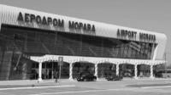









Our clients
Energy sector
Private sector
Transportation
Retail
Education
www.telegroup-ltd.com
Confidential and proprietary information of
TeleGroup. © All rights reserved worldwide

Slide 14
Selected references
Western Balkans, EU, Middle East
www.telegroup-ltd.com
Confidential and proprietary information of
TeleGroup. © All rights reserved worldwide

Slide 15

Selected references
Financial sector
www.telegroup-ltd.com
Confidential and proprietary information of
TeleGroup. © All rights reserved worldwide

Slide 16

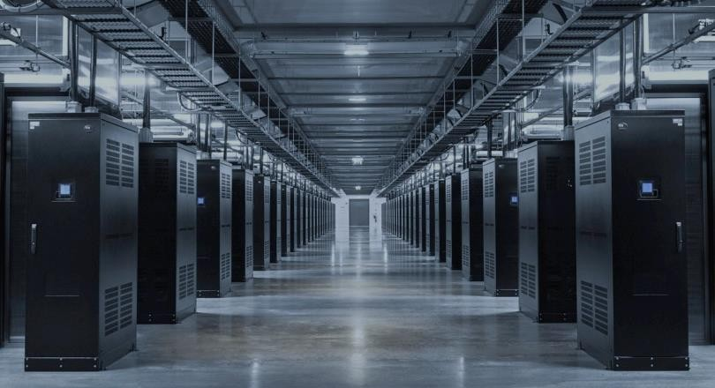
NATIONAL BANK OF SERBIA
Modernization & protection of ICT systems
Implementation of Trend Micro Endpoint security solution
Implementation of Cisco & Check Point solution for
protection of Disaster Recovery location
Implementation of IBM storage solution
Data Center Enhancement
  System for establishing a continuous location availability in active/active mode – DELL EMC solution
  Establishing a new backup location with infrastructure for critical system recovery – DELL EMC solution
Explore Data Center solutions
www.telegroup-ltd.com
Confidential and proprietary information of
TeleGroup. © All rights reserved worldwide

Slide 17

NLB BANK, REPUBLIC OF SRPSKA
Virtualization IS & implementation of Disaster Recovery location
Implementation of Data Center platform with DR location
Migration of user applications to virtual
environment
High availability configuration system with synchronized backup on Disaster Recovery location for core banking applications and other crucial bank systems
Hardware based on HPE server equipment
Software based on VMware vSphere virtualization
Explore DC solutions
www.telegroup-ltd.com
Confidential and proprietary information of
TeleGroup. © All rights reserved worldwide

Slide 18

WIENER INSURANCE, REPUBLIC OF SRPSKA
Development of Webshop solution
TeleGroup has developed a CMS application solution for online insurance product sale which allows for:
  Administration of users and products
  Advanced analytics
  Personalized sales
Simple and easy management of the web shop portal using CMS system
Online insurance policy payments using credit cards and integration with reliable payment gateway providers
Explore software development services
www.telegroup-ltd.com
Confidential and proprietary information of
TeleGroup. © All rights reserved worldwide

Slide 19

Selected references
Transport & logistics
www.telegroup-ltd.com
Confidential and proprietary information of
TeleGroup. © All rights reserved worldwide

Slide 20
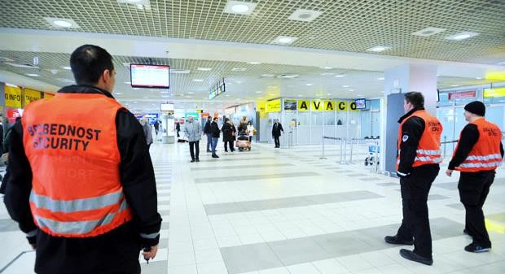
AIRPORT NIKOLA TESLA BELGRADE, SERBIA
Implementation of Technical security and Radio communication systems
IP video surveillance system implementation
  400 cameras, 2 x 700 channel recorders, 6 video walls
Implementation of Motorola Professional Digital
Radio System for critical communications
All implemented systems are connected with existing Building Management system, which is monitored 24/7
Explore technical security systems
www.telegroup-ltd.com
Confidential and proprietary information of
TeleGroup. © All rights reserved worldwide

Slide 21
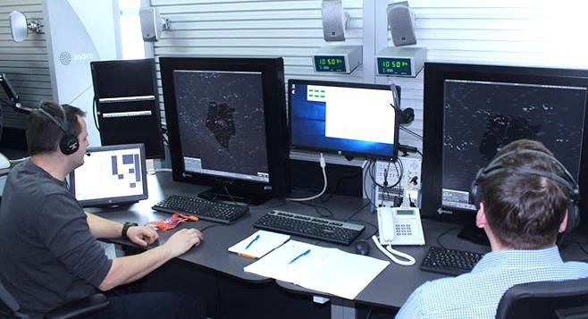
BHANSA AIR TRAFFIC CONTROL AGENCY, BOSNIA AND HERZEGOVINA
Next generation Multiservice network upgrade
Implementation of critical communications system
Implementation of Cisco MPLS VPN network and IP Multicast routing system in function of INDRA system (Air Traffic Automation System)
Integrated cybersecurity system: CheckPoint NGFW, Blue Coat multifactor authentication, SevOne system for monitoring of device and apps performance
Explore IT solutions
www.telegroup-ltd.com
Confidential and proprietary information of
TeleGroup. © All rights reserved worldwide

Slide 22
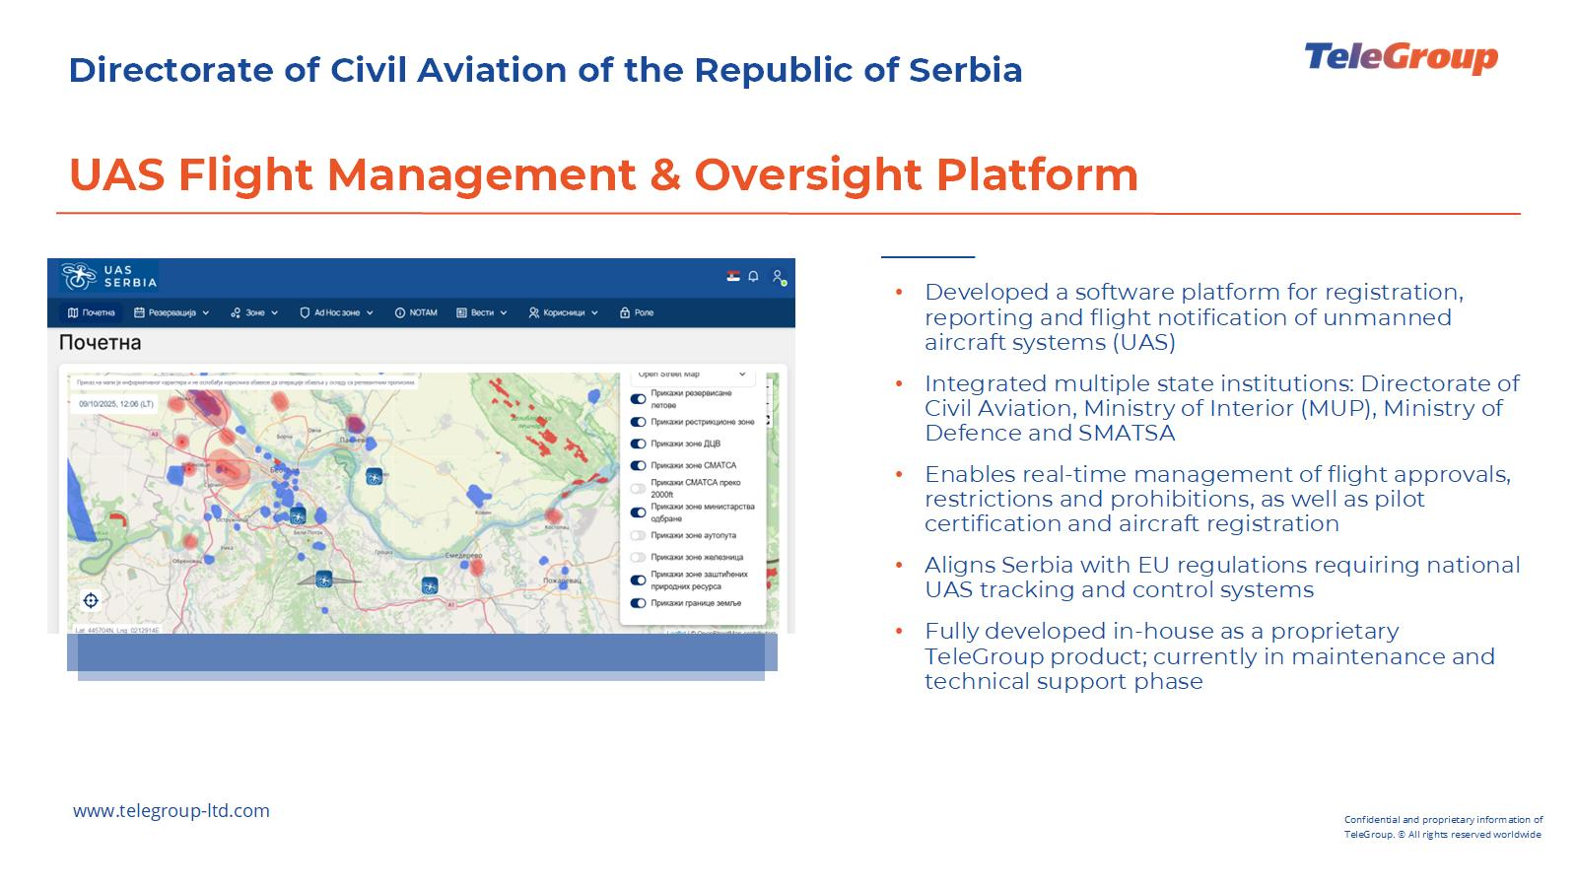

Slide 23
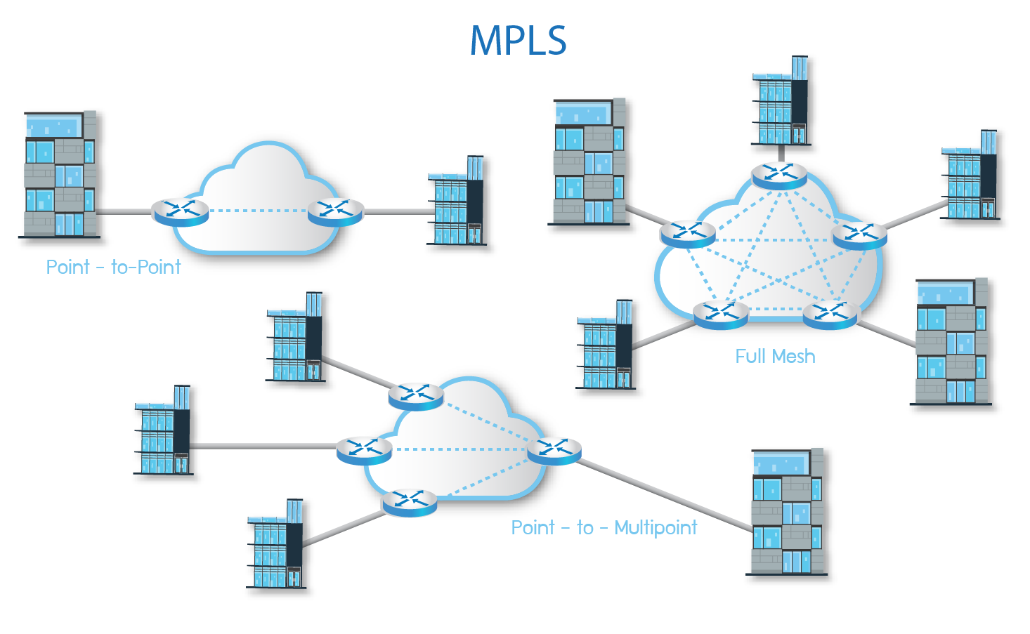
Engineering Design Project for the Replacement and Upgrade of the Telecommunications Network
Design of the future mission-critical BHANSA IP MPLS network.
The goal of the project was to design a reliable, high-capacity network that meets all requirements using appropriate technologies, protocols, and architecture, ensuring scalability, resilience, efficient operation, simplified and centralized management and monitoring, and future expansion.

Slide 24
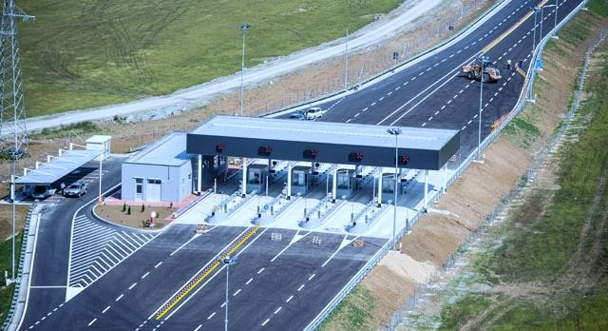
PE ROADS OF REPUBLIC OF SRPSKA
Implementation of ITS system along the highway
Design and construction of over 100km of optical infrastructure along the highway – Doboj – Banja Luka
Construction of a Traffic Control Center and 3 toll
stations
Traffic monitoring, variable VMS signaling management
Speed control and use of traffic lanes (LSCS)
Determining weather conditions on roads and informing participants (weather stations)
Video surveillance and system for detecting traffic
parameters
Incident detection systems
Unauthorized vehicle size detection systems (vehicle height, width, length)
Check out video Case Study
www.telegroup-ltd.com
Confidential and proprietary information of
TeleGroup. © All rights reserved worldwide

Slide 25
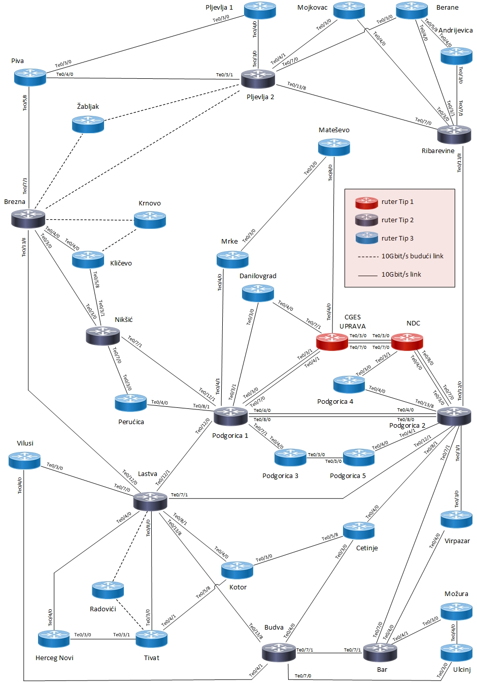
Implementation and design - IP/MPLS Network
New MPLS architecture ensures full redundancy at optical and equipment levels, fast convergence, advanced traffic engineering, and guaranteed service quality for critical applications.
The network is centrally managed, enabling unified monitoring, configuration, and service provisioning, with strict prioritization of critical services over non-critical traffic.

Slide 26
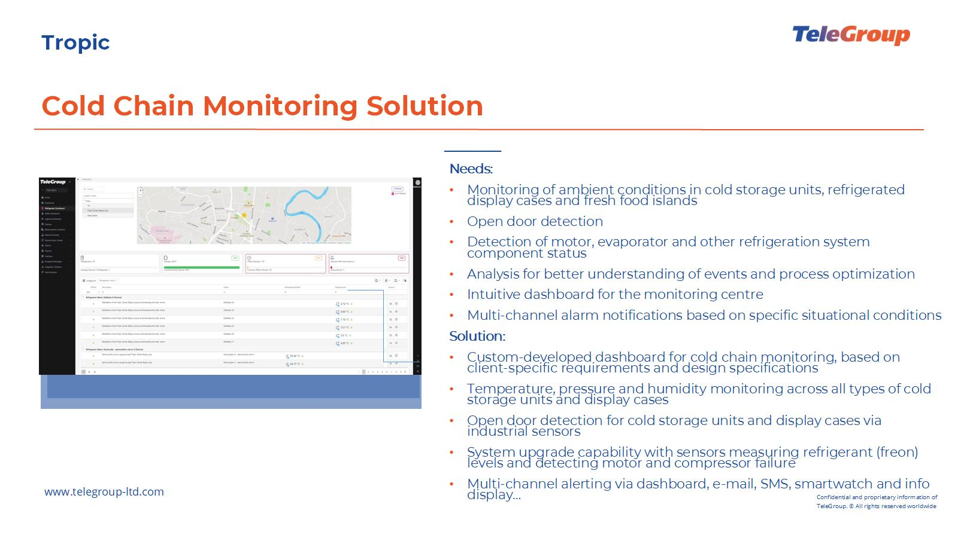

Slide 27
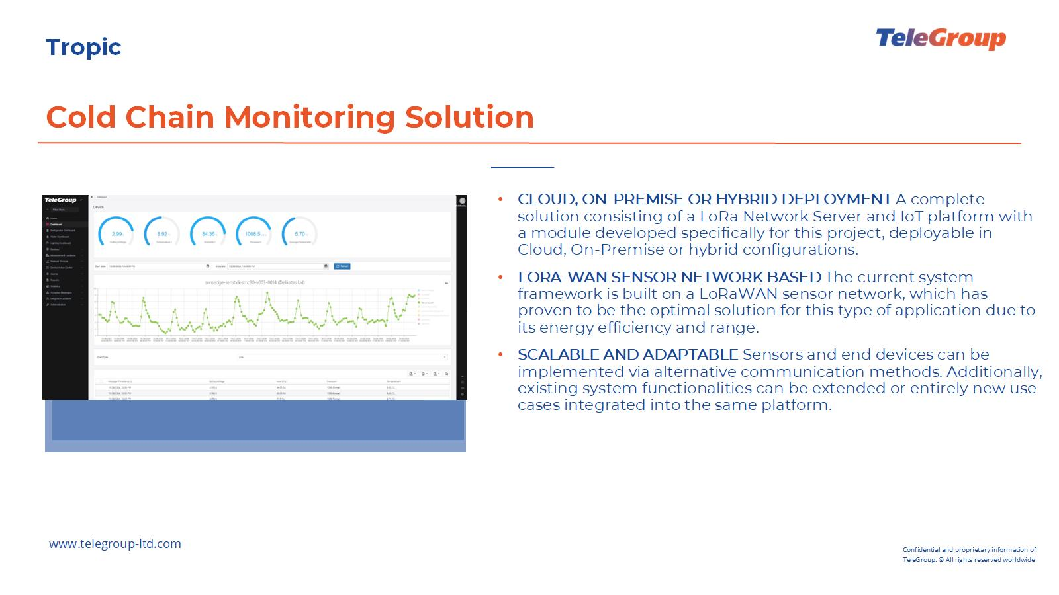

Slide 28

Selected references
Energy Industry
www.telegroup-ltd.com
Confidential and proprietary information of
TeleGroup. © All rights reserved worldwide

Slide 29
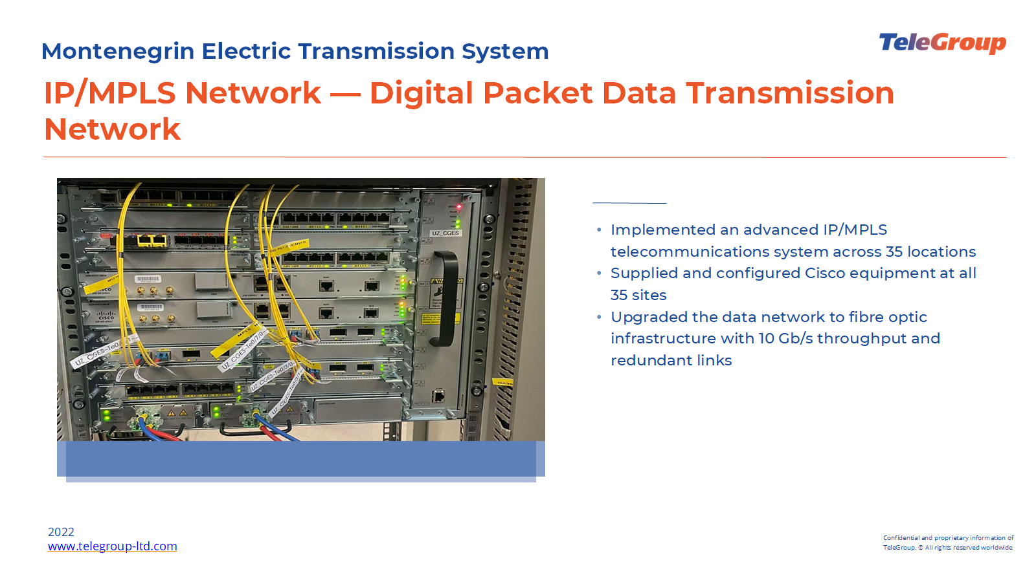

Slide 30


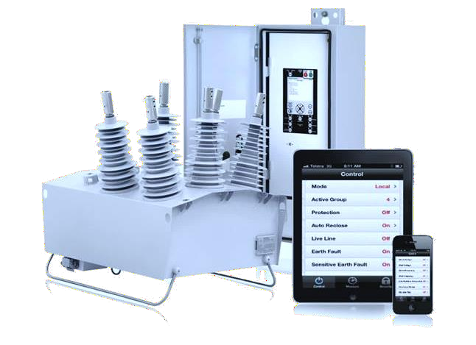
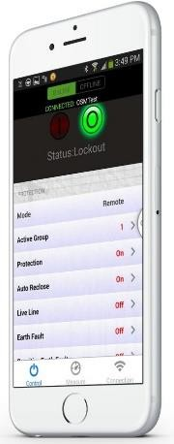
ELECTRIC POWER INDUSTRY OF SERBIA, GASPROMNEFT, ELEKTRO BIJELJINA REPUBLIC OF SRPSKA
Perfect solution for Smart Grid networks
Delivery of Noja Power automatic reclosers for Smart Grid networks
We are the exclusive distributor of the Noja Power
brand for the Western Balkans
Application for remote management
CMS, PQS & Smart Grid Automation software
Explore Smart Grid solutions
www.telegroup-ltd.com
Confidential and proprietary information of
TeleGroup. © All rights reserved worldwide

Slide 31
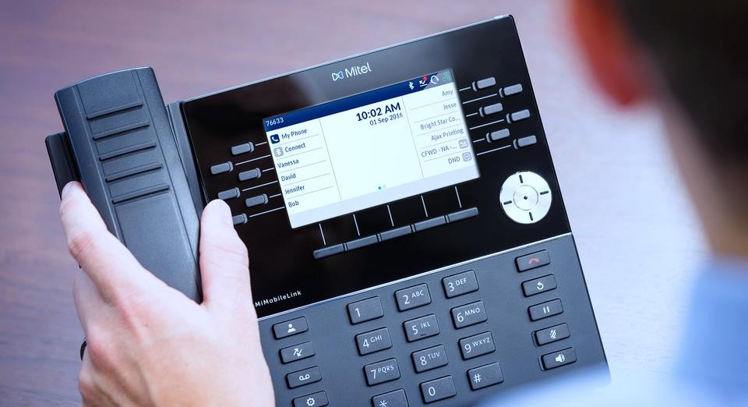
GASPROMNEFT SERBIA (ex NIS)
Integration of ICT systems and networks
Building of telecommunications infrastructure for connection of distant locations
Implementation of Mitel (ex Aastra) MX-ONE TSE
v.4.1 IP communication system
Delivery and implementation of networking equipment for indoor cabling for connecting 205 petrol stations
Delivery and implementation of Polycom HDX video conferencing system and delivery of CX 5000 Polycom system intended for integration with Microsoft Lync environment
Explore IT solutions
www.telegroup-ltd.com
Confidential and proprietary information of
TeleGroup. © All rights reserved worldwide

Slide 32


Selected references
Healthcare
www.telegroup-ltd.com
Confidential and proprietary information of
TeleGroup. © All rights reserved worldwide

Slide 33
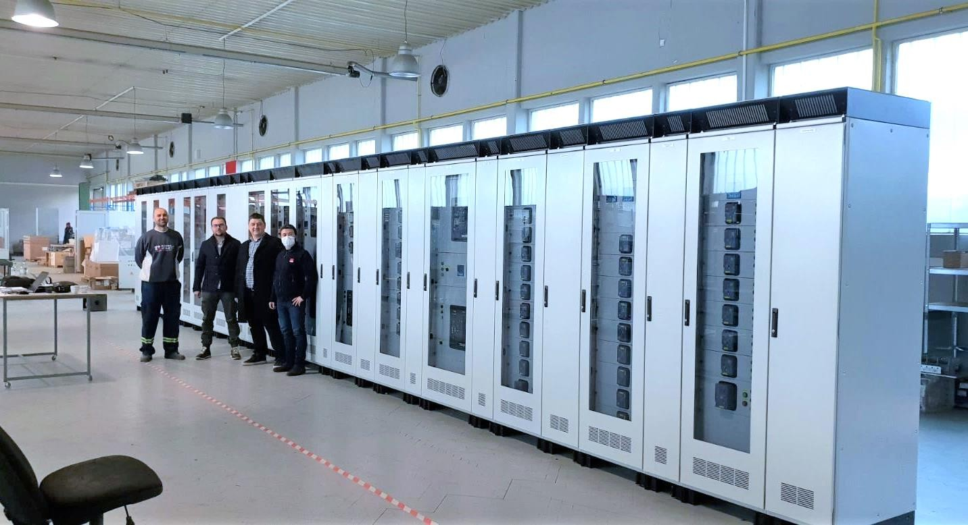
CLINICAL CENTER OF SERBIA
Modernization and protection of IT resources
Engineering works in the domain of adaptation, reconstruction and capacity upgrade of the Clinical Centre of Serbia
Construction of two laboratories - Fire Eye - in
Belgrade and Niš
Implemented systems
  Delivery of equipment and installation of high voltage systems
  Video surveillance system
  Wi-Fi system
  Intercom system
  Access control system
  Fire alarm system
  Passive computer and telephone network
  Building Management and SCADA systems
Explore IT solutions
www.telegroup-ltd.com
Confidential and proprietary information of
TeleGroup. © All rights reserved worldwide

Slide 34
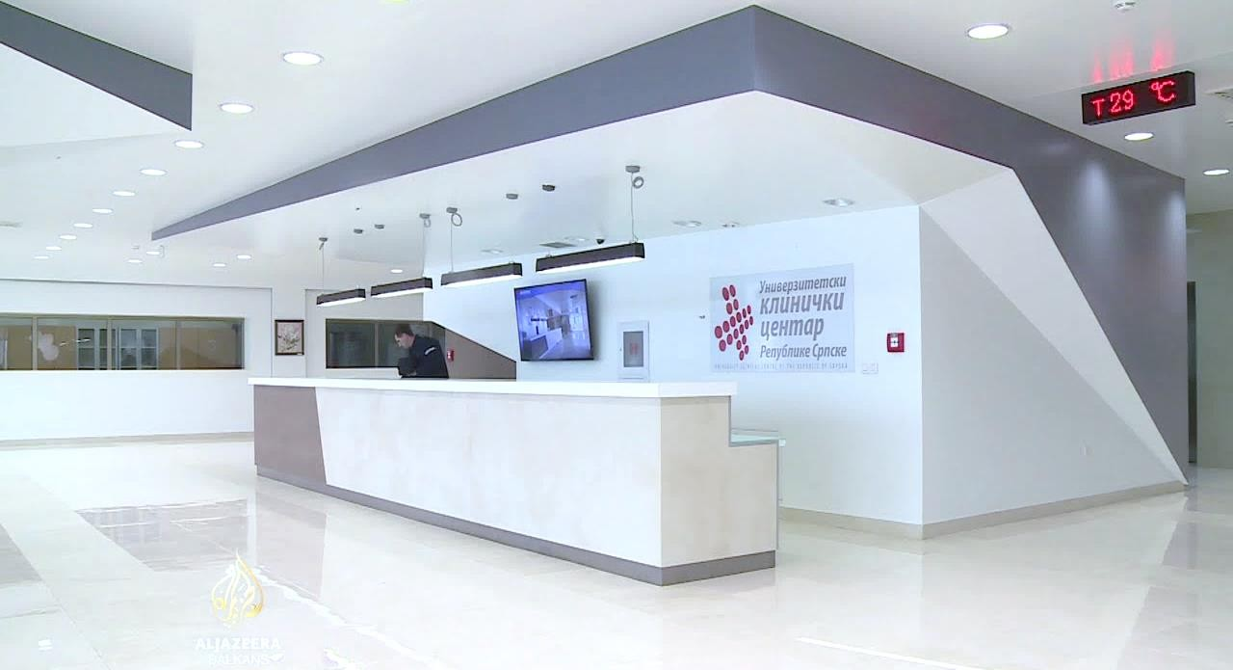
CLINICAL CENTER, REPUBLIC OF SRPSKA
Modernization of communication system
Implementation of the Mitel (ex Aastra) MX-ONE TSW IP communication system
Integrated DECT system with over 70 base stations and
over 100 DECT telephones
Installation of CISCO WebEx board for video conferences
Implementation of the "TGtariff" software solution for detailed monitoring and analysis of telephone traffic
Installation of a GSM Gateway that is connected to the telephone system (switchboard) via a SIP transmitter in order to optimize costs and connect mobile phones from the VPN GSM group
Installation of a server/storage platform on which PACS software is implemented on CISCO/HP equipment
Maintenance of UPS equipment serving DATA centre KC BL on high-power RIELLO platform
Explore communication solutions
www.telegroup-ltd.com
Confidential and proprietary information of
TeleGroup. © All rights reserved worldwide

Slide 35

CLINICAL CENTRE OF MONTENEGRO
Strengthening the health care system in Montenegro
Project for the implementation of a new medical information system and digital transformation of medical services at the Clinical Centre
This project is supported by the Ministry of Health and the offices of the United Nations Development Program (UNDP) in Montenegro
The system has so far been implemented at six clinics
The project included the implementation of a medical information system, business IS for the management of material, human and financial resources as well as a business intelligence solution for optimal management of processes and resources
Explore software solutions
www.telegroup-ltd.com
Confidential and proprietary information of
TeleGroup. © All rights reserved worldwide

Slide 36

Selected references
Private and public enterprises
www.telegroup-ltd.com
Confidential and proprietary information of
TeleGroup. © All rights reserved worldwide

Slide 37

UTILITY COMPANY OBJEDINJENA NAPLATA NIŠ, SERBIA
Development & implementation of mPayment platform
TeleGroup has developed the mPayment platform for comfortable and secure payment without waiting in lines at billing points at any time
Strategic cooperation with Telekom Serbia and AIK
Bank
Confidential user data is not stored on a mobile phone but is stored on a protected cloud instance within the borders of Serbia
Maximum security of financial transactions using
mPIN code
Communication between mPayment system, banks, mobile operator and vendors is done via encrypted protocol - SSL, hardware VPN ...
Software development
www.telegroup-ltd.com
Confidential and proprietary information of
TeleGroup. © All rights reserved worldwide

Slide 38
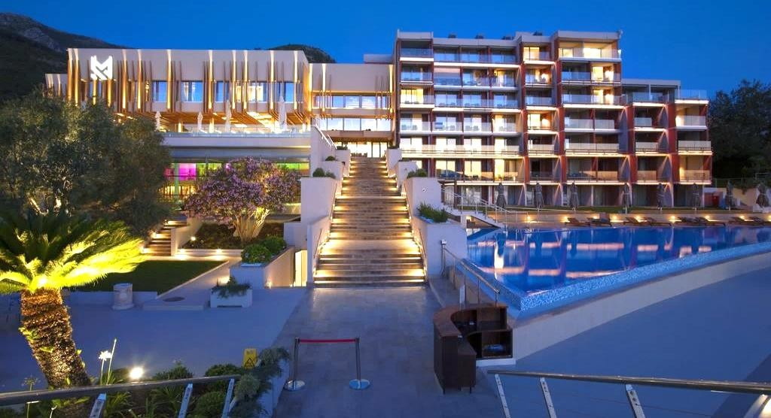
HOTEL MAESTRAL, MONTENEGRO
Modernization of IT resources
Implementation of next-generation Cisco network infrastructure
Implementation of advanced Matrix access control
system
Work on customizing and implementing a time and attendance application
Implemented Indigo Vision video surveillance system
Modernized conference room
Implementation of Cisco networking solution and specialized video surveillance system for the Casino monitoring purposes
Explore IT solutions
www.telegroup-ltd.com
Confidential and proprietary information of
TeleGroup. © All rights reserved worldwide

Slide 39

Selected references
Government institutions
www.telegroup-ltd.com
Confidential and proprietary information of
TeleGroup. © All rights reserved worldwide

Slide 40
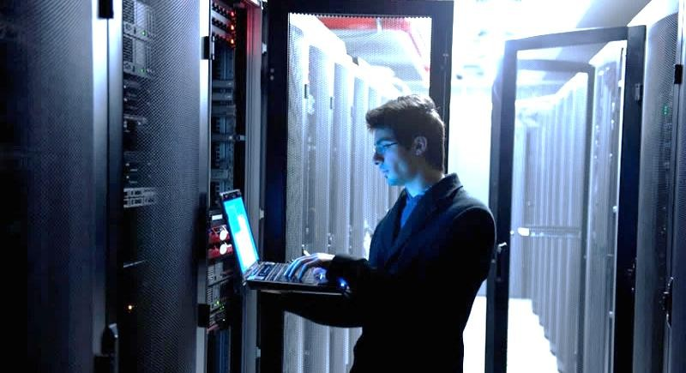
ANTI-CORRUPTION AGENCY OF SERBIA
Building and equipping the Data Centery
Realization of a complete system of heating, air conditioning, ventilation, overpressure…
Implementation of a complete technical protection
system
Cisco Network Equipment Delivery
Implementation of Data Warehouse platform based on IBM and EMC hardware and software
Implementation of Document Management software
Explore DC solutions
www.telegroup-ltd.com
Confidential and proprietary information of
TeleGroup. © All rights reserved worldwide

Slide 41
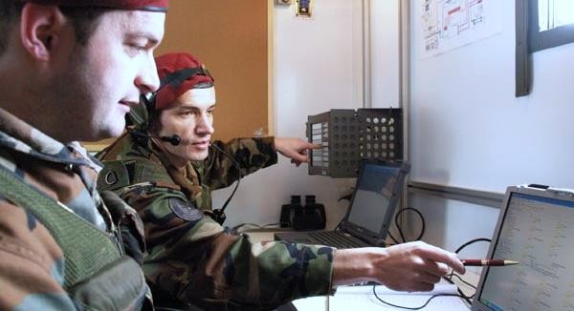
MINISTRY OF DEFENSE, SERBIA
Modernization & maintenance of communication systems
Aastra 18 MX-ONE TSW communication systems delivery and commissioning
Upgrade and expansion on 14 additional systems
Implementation of monitoring and control centers in Belgrade, Novi Sad and Niš
The total number of ports in the system with the latest version of the software exceeds 15 000
Explore communication solutions
www.telegroup-ltd.com
Confidential and proprietary information of
TeleGroup. © All rights reserved worldwide

Slide 42

HIGH JUDICIAL AND PROSECUTORIAL COUNCIL OF BOSNIA AND HERZEGOVINA
Implementation of Fault tolerant storage solution
Implemented SAN storage solution with active-active Fault tolerant architecture
Storage and SAN switching solution is based on
Huawei OceanStor and SAN solutions
Solution implemented on primary and the Disaster Recovery location making the active-active cluster
Within the solution implemented external virtualization of a second storage system
Explore DC solutions
www.telegroup-ltd.com
Confidential and proprietary information of
TeleGroup. © All rights reserved worldwide

Slide 43
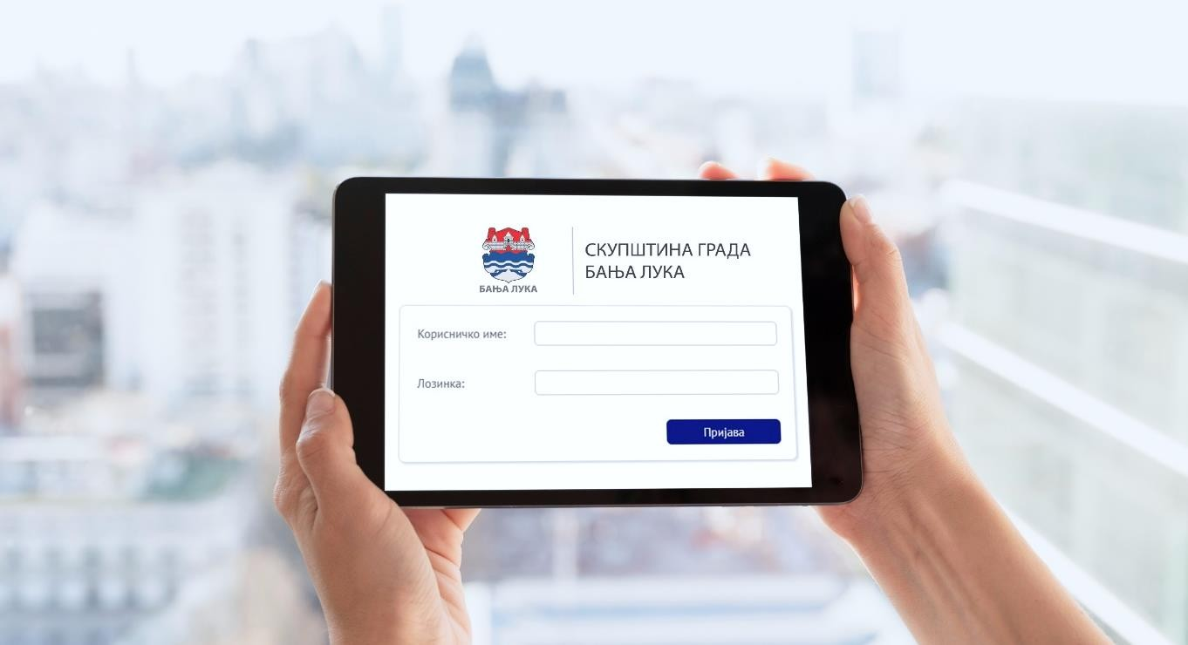
CITY HALL, BANJA LUKA
Development & implementation of e-Assembly solution
TeleGroup has developed a dedicated solution for improving processes of parliamentary bodies
Web-oriented, modular, scalable software solution for preparation, holding and post-analysis of assembly sessions
Fully digitalized processes
Hosting: AWS, Cloud, On-premise
Explore software development
www.telegroup-ltd.com
Confidential and proprietary information of
TeleGroup. © All rights reserved worldwide

Slide 44
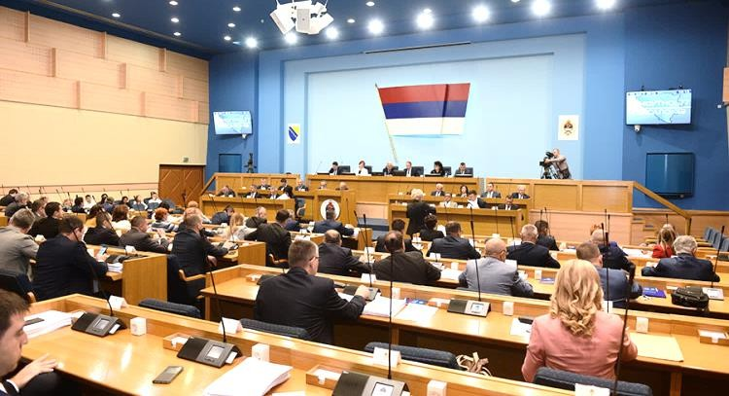
NATIONAL ASSEMBLY, REPUBLIC OF SRPSKA
Design and implementation of conferencing system
Implementation of IT infrastructure for system connection
Design and implementation of digital audio, video
and control and management systems
Design and implementation of SHURE DIS DCS 6000 conference system for 120 parliament members
Explore AC / VC solutions
www.telegroup-ltd.com
Confidential and proprietary information of
TeleGroup. © All rights reserved worldwide

Slide 45

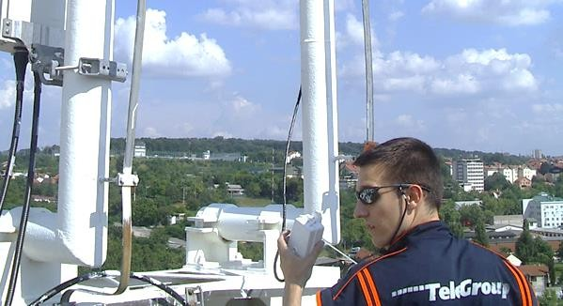
CITY OF ČAČAK, SERBIA
The first Safe City project in Serbia
The whole city under video surveillance
Building of a wireless broadband network in the function of an integrated video surveillance system
Delivery, installation and commissioning of video equipment
Explore video surveillance solutions
www.telegroup-ltd.com
Confidential and proprietary information of
TeleGroup. © All rights reserved worldwide

Slide 46

Selected references
Telecom operators & service providers
www.telegroup-ltd.com
Confidential and proprietary information of
TeleGroup. © All rights reserved worldwide

Slide 47
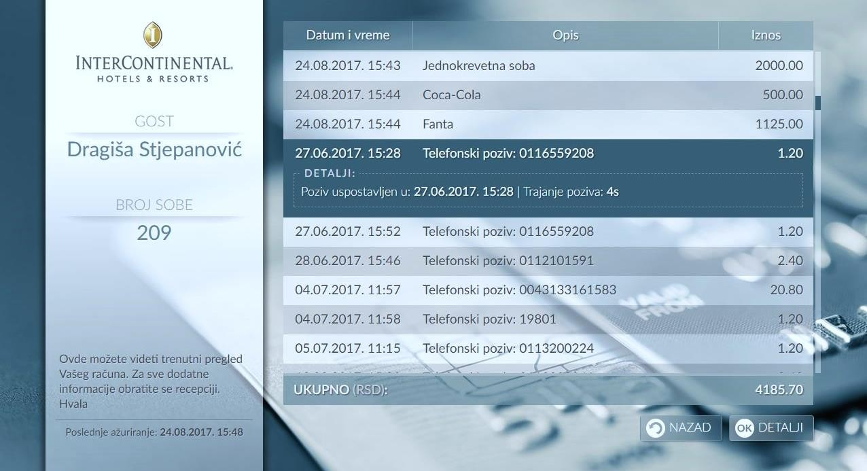
TELEKOM SERBIA
Hotel Information System
We have developed custom cloud-ready Hotel Information System and integrated it with the existing IPTV and Voice services
HIS enables simple management of hotel guest services such as check-in & check-out and issuing unique invoices...
This is a unique and centralized solution for managing STB devices and fixed telephony services
HIS is intended for hotels that use the IP Centrex service of Telekom Serbia, based on the Ericsson IMS platform, as well as the IPTV service based on the Huawei MSVS platform
It is an independent in-house PMS solution that hotels can additionally use for their daily operations
Delivery of adapters and integration with existing Micros Fidelio PMS system
Explore IPTV solutions
www.telegroup-ltd.com
Confidential and proprietary information of
TeleGroup. © All rights reserved worldwide

Slide 48
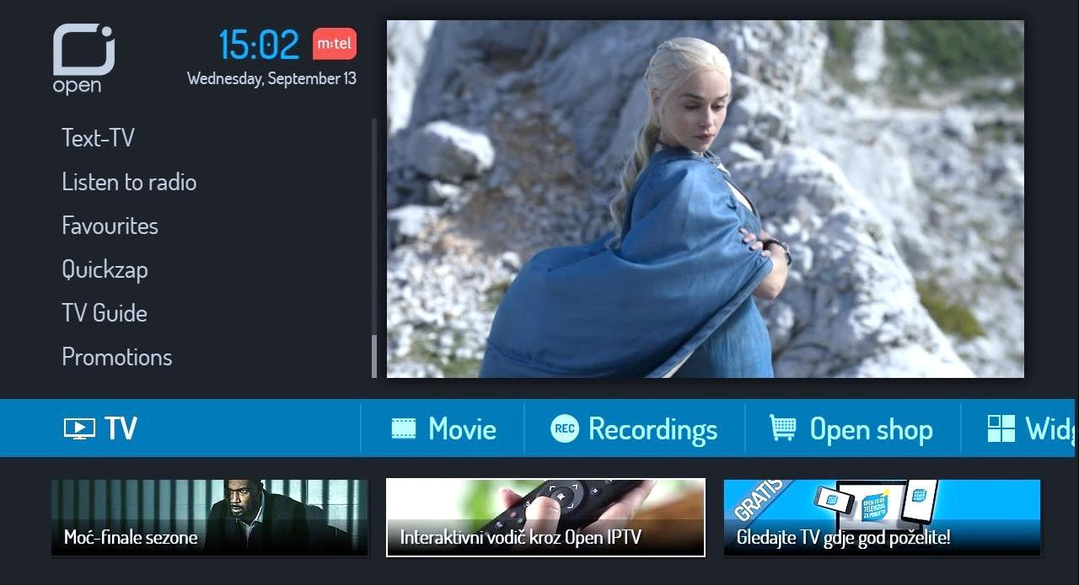
MTEL BANJA LUKA, REPUBLIC OF SRPSKA
The first IPTV multiscreen solution in the region
We have implemented Nordic DreamGallery Middleware software to deliver integrated multimedia content
End users are enabled to manage and consume multimedia content on all devices (PC, TV, smart phone, tablet ...)
We have also implemented Verimatrix Digital Rights Management solution to protect video content from piracy
We have developed and implemented a widget applications for Set-top-Box devices - Facebook, YouTube, Twitter, weather forecast, online shopping, sports betting, news - which turn every TV into a Smart TV
We have a long-term SLA to support and maintain the system
Watch the case study
www.telegroup-ltd.com
Confidential and proprietary information of
TeleGroup. © All rights reserved worldwide

Slide 49
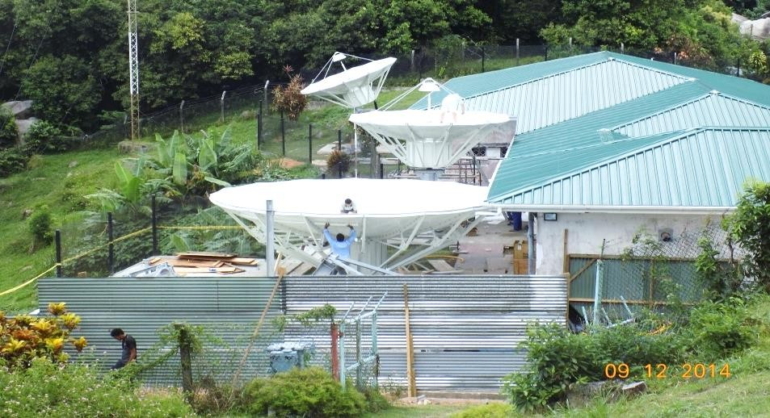
CABLE & WIRELESS SEYCHELLES & TELECOM NAMIBIA
Implementation of satellite communication system
Satellite system is in function of IPTV platform for Cable & Wireless
Terrestrial satellite stations for Telekom Namibia
Design, construction, delivery of equipment, integration and maintenance of the satellite system
Receiving station for cable and IPTV headend
VSAT (Very Small Aperture Terminal) networks and stations
Earth satellite stations
Explore infrastructure services
www.telegroup-ltd.com
Confidential and proprietary information of
TeleGroup. © All rights reserved worldwide

Slide 50
Selected references
Cybersecurity
www.telegroup-ltd.com
Confidential and proprietary information of
TeleGroup. © All rights reserved worldwide

Slide 51

POŠTANSKA ŠTEDIONICA BANK, SERBIA
IT system protection
Implementation of Trend Micro Endpoint security solution
Implementation of Cyber Ark system for management and monitoring of privileged accounts
Signed an annual contract for system maintenance
Implementation of Netscout solution and maintenance of DDoS attack prevention system
Implementation of Public Key Infrastructure
solution
  Infrastructure of public keys based on Entrust technology, implemented and configured in high-availability mode
  SLA signed for 12 months
Explore Cybersecurity solutions
www.telegroup-ltd.com
Confidential and proprietary information of
TeleGroup. © All rights reserved worldwide

Slide 52


TELEKOM SERBIA
Protection of the corporate network through the control of internet traffic
Implementation of Symantec / BlueCoat secure web gateway solution
Secure access to web content enabled for 7000
employees
Integration with the existing sandboxing solution enabled protection against Zero-Day attacks
Implementation of Firewall Management solution for easy management and optimization of Firewall devices
Explore Cybersecurity solutions
www.telegroup-ltd.com
Confidential and proprietary information of
TeleGroup. © All rights reserved worldwide

Slide 53

MTEL BANJA LUKA, REPUBLIC OF SRPSKA
Comprehensive network and data protection
Integration of physical and logical access control with PKI
Installation, integration and commissioning of the
Blue Coat Internet access control system
Installation, integration and commissioning of the Intrusion Prevention System based on IBM ISS and Site Protector platforms
Maintenance of TrendMicro OfficeScan Client / Server Standard Edition antivirus software for 2000 end users
Firewall-1 GX software platform designed to protect GTP / GPRS systems - a solution based on CheckPoint architecture
Explore Cybersecurity solutions
www.telegroup-ltd.com
Confidential and proprietary information of
TeleGroup. © All rights reserved worldwide

Slide 54

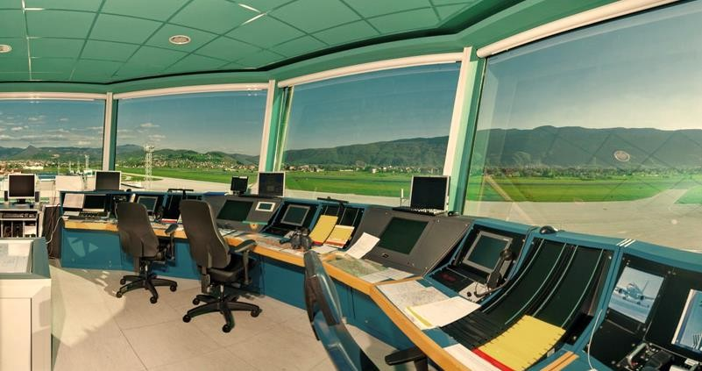
BHANSA, BOSNIA & HERZEGOVINA
Next generation firewall protection
Checkpoint NGFW project
Migration from legacy appliances to the Next-Gen firewall series
Migration and redesign of policies to fit to new Database and OS versions
Remote VPN configuration
URL filtering setup
Explore Cybersecurity solutions
www.telegroup-ltd.com
Confidential and proprietary information of
TeleGroup. © All rights reserved worldwide

Slide 55

Selected references
Designing & building of telecommunication networks
www.telegroup-ltd.com
Confidential and proprietary information of
TeleGroup. © All rights reserved worldwide

Slide 56

MAIN DESIGN PROJECTS FOR DIFFERENT USERS
Designing of fixed telecommunication networks
200 projects with a total of 170,000 pairs of access network and 70 km of telecommunication ducts for Telekom Serbia and Mtel Banja Luka
1300 km of optical network for Telekom Serbia, Mtel
Banja Luka, ETF Belgrade, Transneft
Preliminary and main project for the construction of 831 km of optical infrastructure along the highway E70 & E75 for the investor Putevi Srbija
Idea and main design for the adaptation of communication network, remote control and surveillance system along 155 km oil pipeline route Danube- Novi Sad – Pančevo for the Transneft
Design of a local industrial network for data transmission and archiving in the local network of the Brod Oil Refinery
Telecommunication infrastructure
www.telegroup-ltd.com
Confidential and proprietary information of
TeleGroup. © All rights reserved worldwide

Slide 57
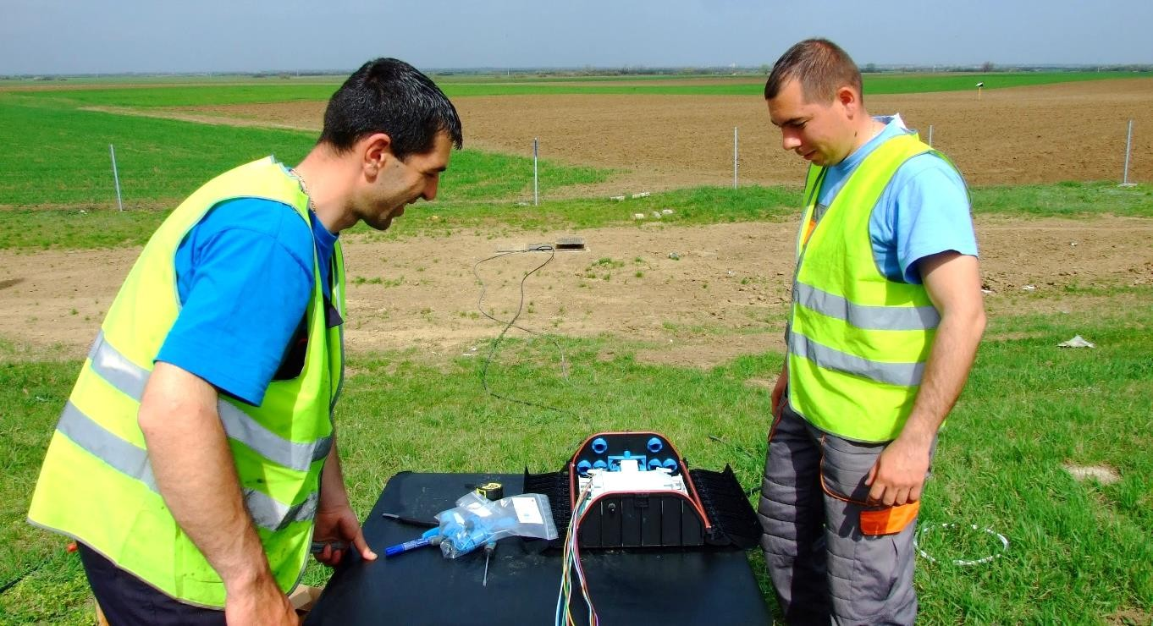
TELEKOM SERBIA AND MTEL BANJA LUKA
Construction of optical transport and access networks
Construction of 900 km of fiber optical infrastructure for Telekom Serbia and Mtel Banja Luka
Building of access network with 220,000 subscribers for Telekom Serbia and 250 km of optical transport network on the following routes:
  Belgrade-Novi Sad
  Kraljevo-Raska
  Bor-Zlot
  Požega - Kruščica
Telecommunication infrastructure
www.telegroup-ltd.com
Confidential and proprietary information of
TeleGroup. © All rights reserved worldwide

Slide 58
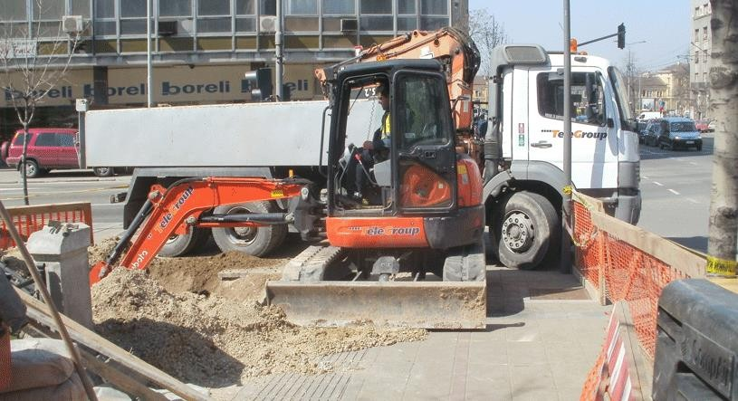
TARGO TELEKOM SERBIA
Building of the METRO network in the city of Belgrade
Project value was cca 900K EUR
250 km of an optical metro network built in Belgrade
Existing water supply sewerage was used for the transport network
Covered 95% of the urban area and connected all parts of the city
Residential and business users are provided with high capacities for multimedia data transmission
Cables are terminated in street cabinets, mini connectors, terminal optical boxes, in building’s halls and at users’ premises
Telecommunication infrastructure
www.telegroup-ltd.com
Confidential and proprietary information of
TeleGroup. © All rights reserved worldwide

Slide 59
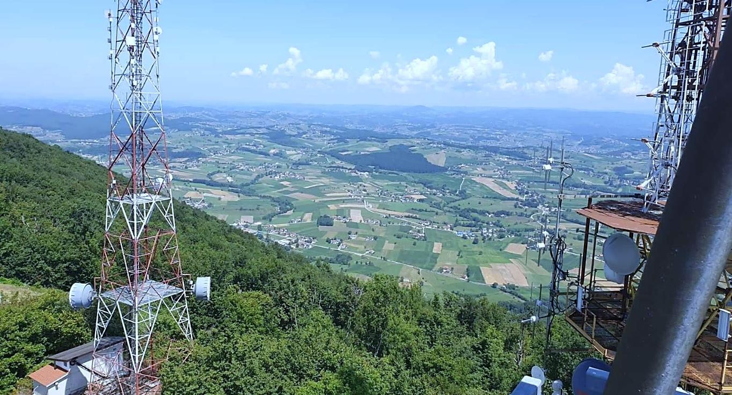
BH TELEKOM, FEDERATION OF BOSNIA AND HERZEGOVINA
Modernization of LTE network
Design and construction of LTE network
Delivery and installation of equipment
System maintenance
Telecommunication infrastructure
www.telegroup-ltd.com
Confidential and proprietary information of
TeleGroup. © All rights reserved worldwide

Slide 60
Selected references
Building technologies
www.telegroup-ltd.com
Confidential and proprietary information of
TeleGroup. © All rights reserved worldwide

Slide 61
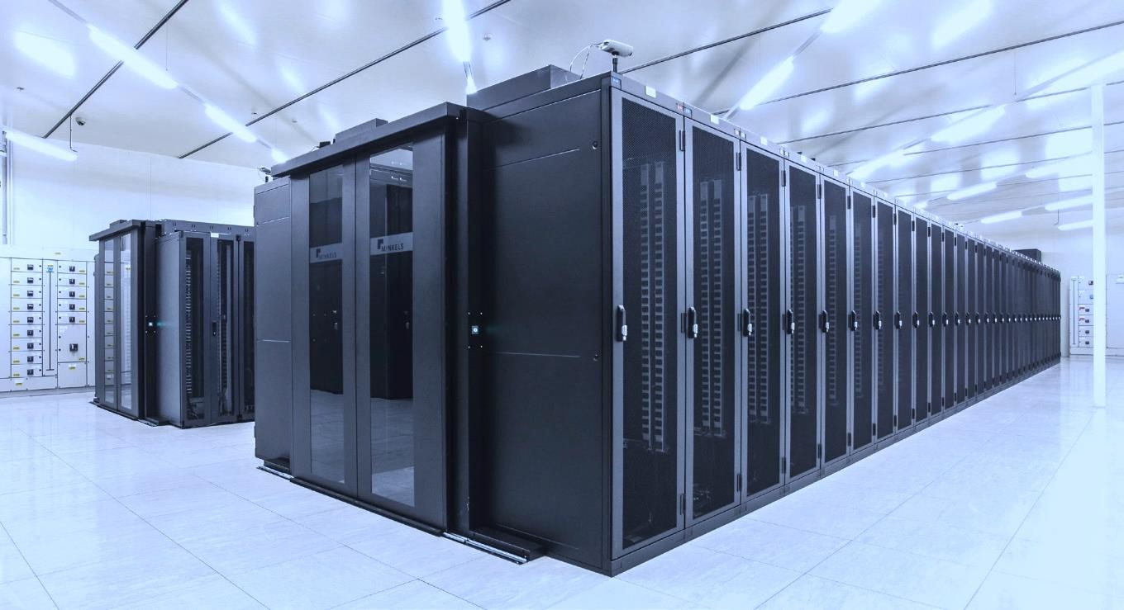
NATIONAL ELECTRICITY TRANSMISSION COMPANY (ELEKTROMREŽE SRBIJE)
Construction of Data Center
Implementation of central management and monitoring system and its equipment
Civil construction works: partition walls, raised
floors, metal and masonry works…
HVAC systems
  Air Handling Units, Heating substation, Continuous pressure increase system, Fire valves, Exhaust fans, Fan coils (four pipe system)
Electricity installations
  Power distribution network, DEA and UPS systems
Security systems
  Automatic alarm and fire extinguishing
  Access control
  Video surveillance
  Burglar protection
Explore DC services
www.telegroup-ltd.com
Confidential and proprietary information of
TeleGroup. © All rights reserved worldwide

Slide 62
Selected references
Transport systems
www.telegroup-ltd.com
Confidential and proprietary information of
TeleGroup. © All rights reserved worldwide

Slide 63
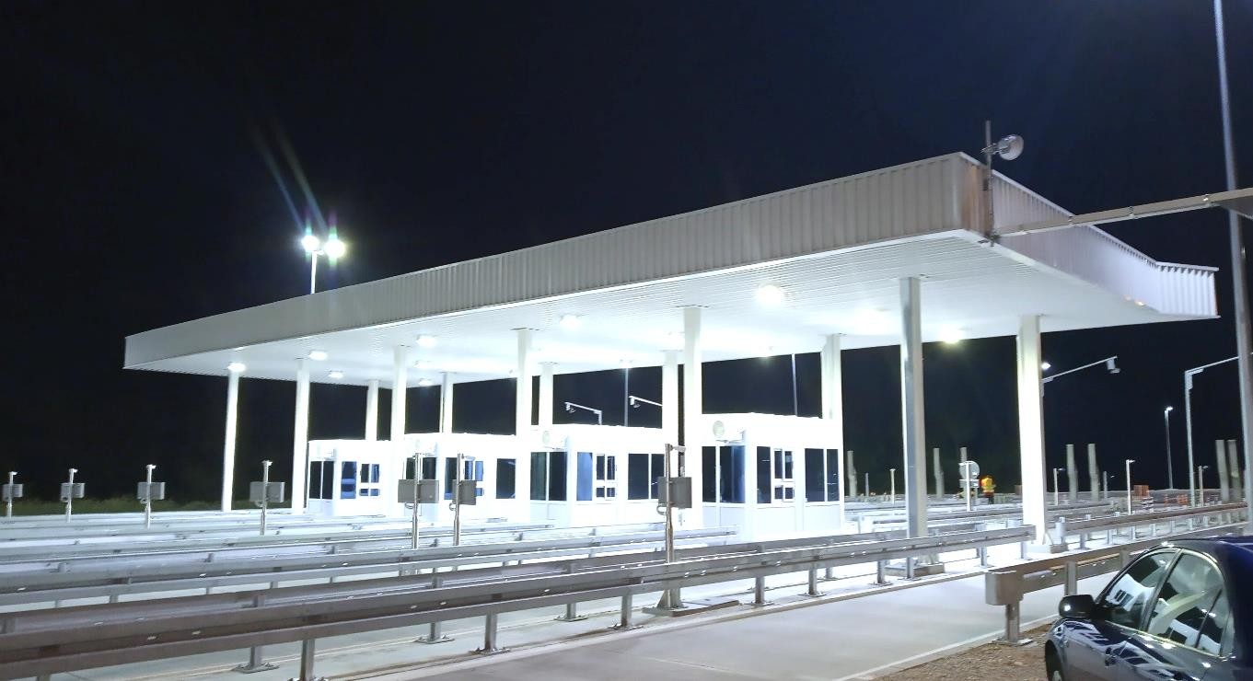
STRABAG AND PE ROADS OF SERBIA
Designing and building of toll stations on government roads
Construction of toll stations on state roads:
  A1 (Highway E-75) section to Macedonia
  A4 (Highway E-80) section to Bulgaria
  A2 (Highway E-763) section Obrenovac-Preljina
Works on construction of electric power systems, installation of video surveillance system with accompanying software
Explore the infrastructure
www.telegroup-ltd.com
Confidential and proprietary information of
TeleGroup. © All rights reserved worldwide

Slide 64
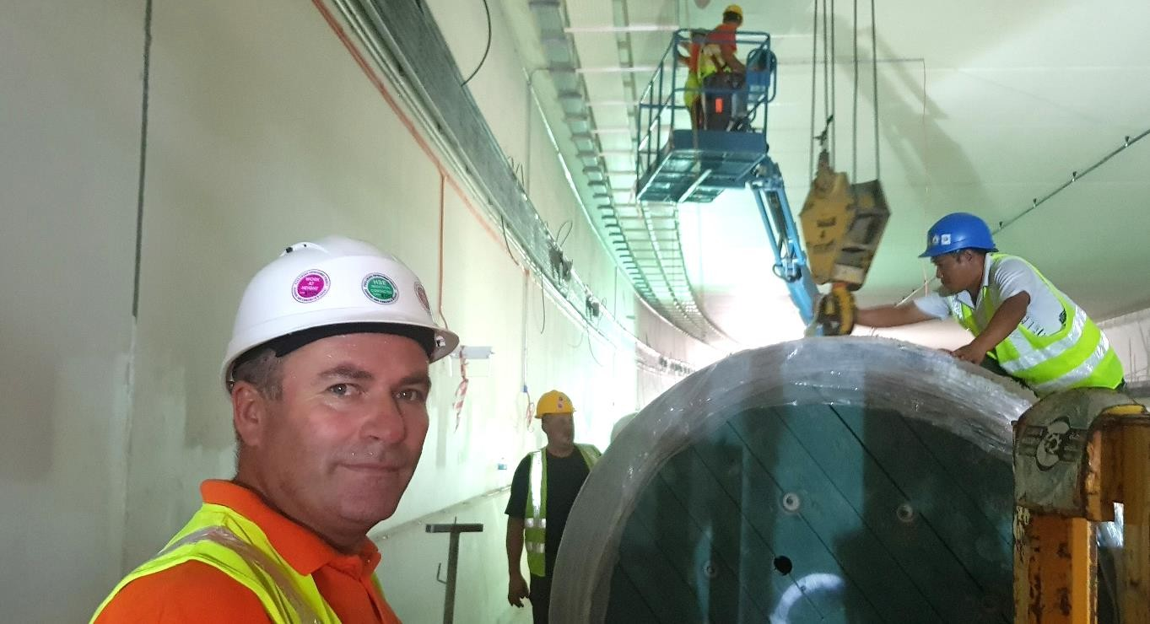
LUSAIL EXPRESSWAY DOHA PROJECT, QATAR
Modernization of signaling and telecommunications systems
Construction of optical infrastructure
Installation of cable trays
Installation of traffic signaling system
Implementation of SOS telephony
Public information and alert system
Implementation of video surveillance system
Explore the infrastructure
www.telegroup-ltd.com
Confidential and proprietary information of
TeleGroup. © All rights reserved worldwide

Slide 65
Selected references
Electric Power Systems
www.telegroup-ltd.com
Confidential and proprietary information of
TeleGroup. © All rights reserved worldwide

Slide 66
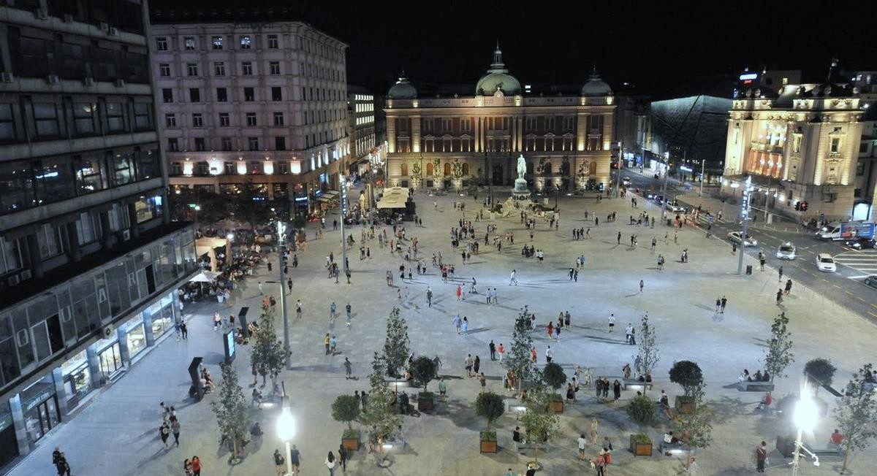
STRABAG, BELGRADE
Construction of lighting and relocation of telco infrastructure
Construction of public lighting on the traffic section
Kolarčeva – Makedonska and functional plateau
lighting of Republic square, as well as pedestrian roads on the plateau sides
Construction of scenic LED lighting – Republic square
plateau and decorative exterior lighting of National
theatre, National museum and ex-building of
Jugoeksport in Kolarceva street; Knez Mihailo monument lighting
Foliage lighting on the square plateau with its cable
installations, LED reflectors and system for remote lighting control
Relocation of complete telecom underground cable
infrastructure with construction of additional capacity
TC ducts and shafts
Construction of lighting signalization and video
surveillance on Kolarčeva-Makedonska-Vasina
intersection and on Francuska – Vasina intersection for the Transport Secretariat
Electric power
www.telegroup-ltd.com
Confidential and proprietary information of
TeleGroup. © All rights reserved worldwide

Slide 67

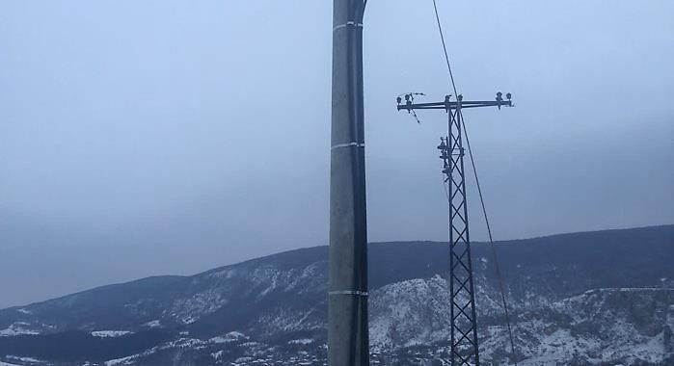
DIFFERENT USERS
Construction of electricity facilities along the E80 highway
Construction of power facilities along the E80 Corridor X highway:
  Chiflik-Staničenje section for Construcciones RUBAU
  Section Chiflik - Pirot for Siemens Serbia
  Section Bela Palanka - Pirot for Trace Balkans
Electric power
www.telegroup-ltd.com
Confidential and proprietary information of
TeleGroup. © All rights reserved worldwide

Slide 68

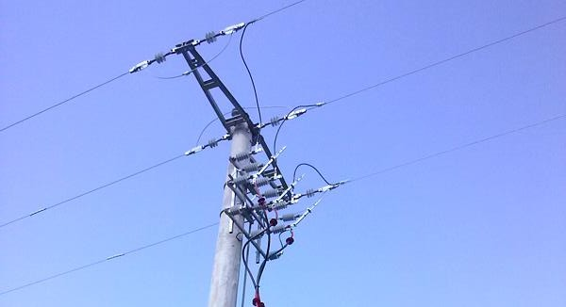
ELECTRIC POWER INDUSTRY OF SERBIA
Construction and maintenance of electric power network
Installation and connection of MBTS 630 kVA at 39 Vojvode Vlahovića street, Belgrade
Construction of power facility of voltage level up to
10kV (commissioning of > 50 systems), Belgrade
Maintenance of power facilities up to 35 kV – Belgrade city network
Construction of access power line 10 / 0.4 kV with overhead electrical substation of 400kVA in Slancio
Reconstruction of power lines in Vranje (installation
of new wood- impregnated poles L=12m)
Electric power
www.telegroup-ltd.com
Confidential and proprietary information of
TeleGroup. © All rights reserved worldwide

Slide 69
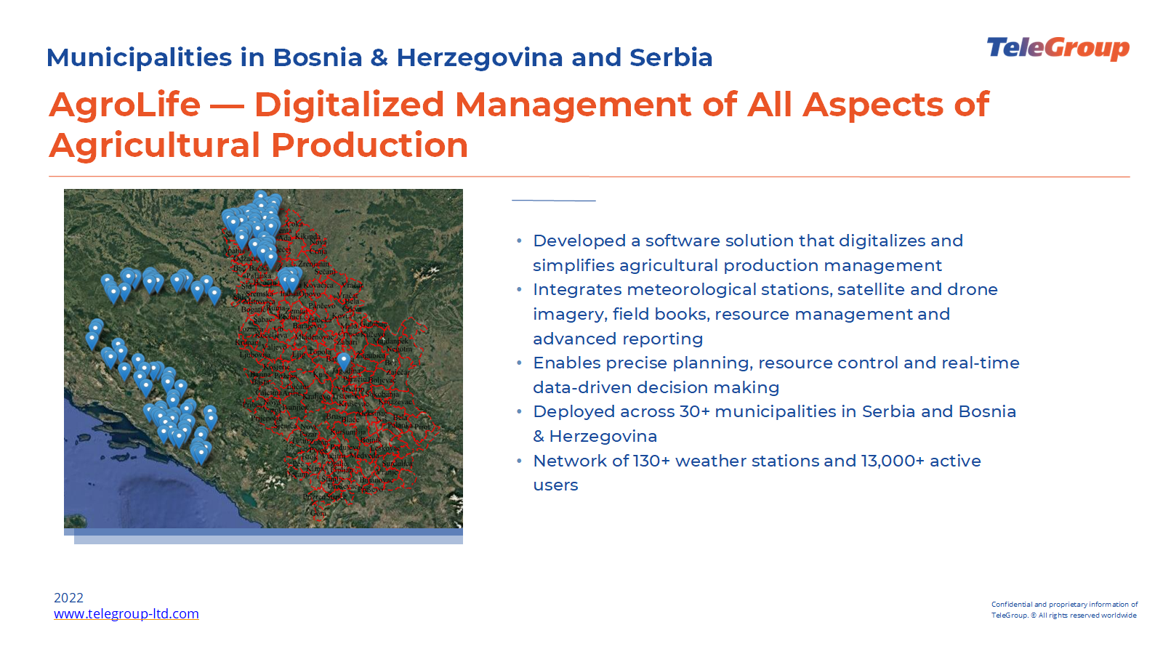

Slide 70

THANK YOU FOR YOUR ATTENTION!
office@telegroup-ltd.com
www.telegroup-ltd.com
www.telegroup-ltd.com

